Slide 1

Gyro Sensor Revisited
By Sanjay and Arvind Seshan

Slide 2
Lesson Objectives
Learn about how older and newer generations of gyro sensors effect the calibration process
Learn how to how to deal with gyro drift with this updated information about the gyro sensor.
Prerequisites: Data wires, Loops, Logic & Comparison Blocks, Introduction to Gyro

Slide 3
Terms to Know
Reset: Current value of the gyro sensor angle is set to “0”. This is what the gyro block with mode set to “reset” does.
Calibration: The gyro calibrates what it considers to be “still”. This sets both the current gyro sensor rate and angle to “0”. This typically occurs when the gyro is connected.
Some people refer to calibration as a “hard reset”. We will call this calibrate through this lesson to reduce the amount of confusion.

Slide 4
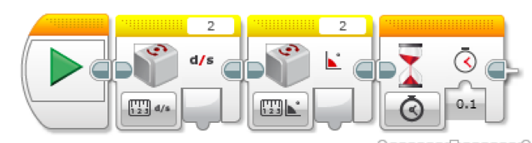
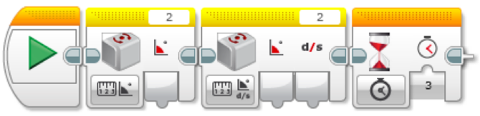
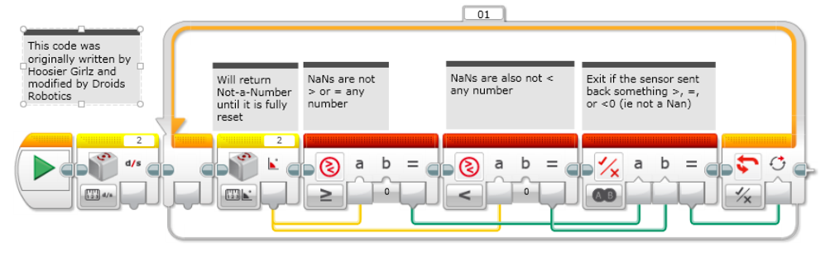
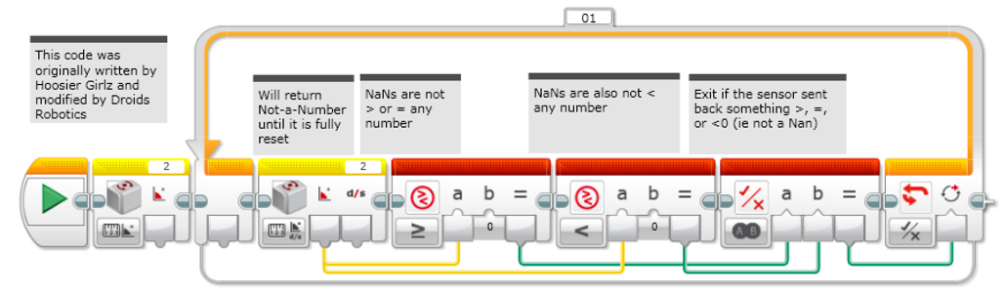
Why Revisit the Gyro?
Recalibration Methods from “Intro to Gyro”
It has been brought to our attention by Mr. Sam Last from North Carolina that certain gyros are acting differently.
On certain newer gyro sensors, the commonly used calibration code for the gyro on the right (switching between angle and rate), does not work (i.e. does not cause the gyro to perform a recalibration).
This is a big issue for anyone using one of the gyro sensors that does not recalibrate with this code.
Strategy 1:
Strategy 2:
Strategy 3:
Strategy 4:

Slide 5
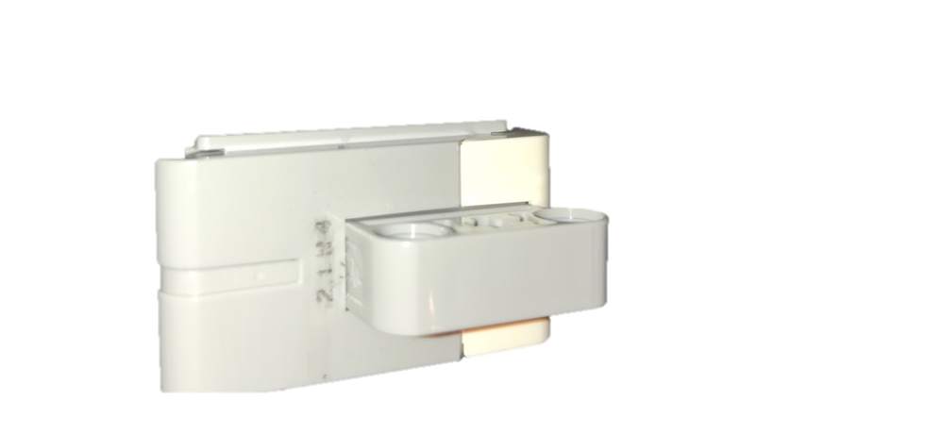
Testing the Gyro Sensors
We obtained data from 30+ gyro sensors purchased in various years around the world
Strategy 4 code (from Introduction to Gyro Lesson) provides a simple way to test if you have a sensor that supports recalibration or not.
On sensors that perform the recalibration, it takes 3 seconds to run this code.
On sensors that do not perform the recalibration, the code runs in < .1 seconds.
We added some timer code to test a gyro sensors by running three recalibrations and averaging to see how long they take.
We thought the problem may be related to the code on the bottom of the gyro (shown in red circle) – so, we recorded this as well.

Slide 6
Results
Sample Gyro Sensor Codes
There is a correlation with the codes printed on the gyros themselves and whether or not they recalibrate correctly.
All gyro sensors ending in N2 and N3 worked. All gyro sensors ending in N4, N5, N6, N7 and N8 did not work.
We have personally tested on N3, N4, N6 and N8. Tests on the others were conducted by friends.
Note: If you complete this lesson and discover new numbers to add to the list (especially any N7 and N8), please email them to us at team@ev3lessons.com.
Old Type
New Type
18N2
20N2
48N2
01N3
02N3
03N3 04N3
05N3
06N3
16N3
17N3 19N3
42N3
43N3
44N3
45N3
47N3
49N3
50N3
51N3
09N4
15N4 20N4 21N4 38N4
39N4
50N4
13N5
17N5
21N5 22N5
27N5 28N5 36N5 45N5
03N6
05N6 06N6
15N6
17N6 20N6
21N6
23N6
29N6
06N7
23N7
28N7
10N8

Slide 7
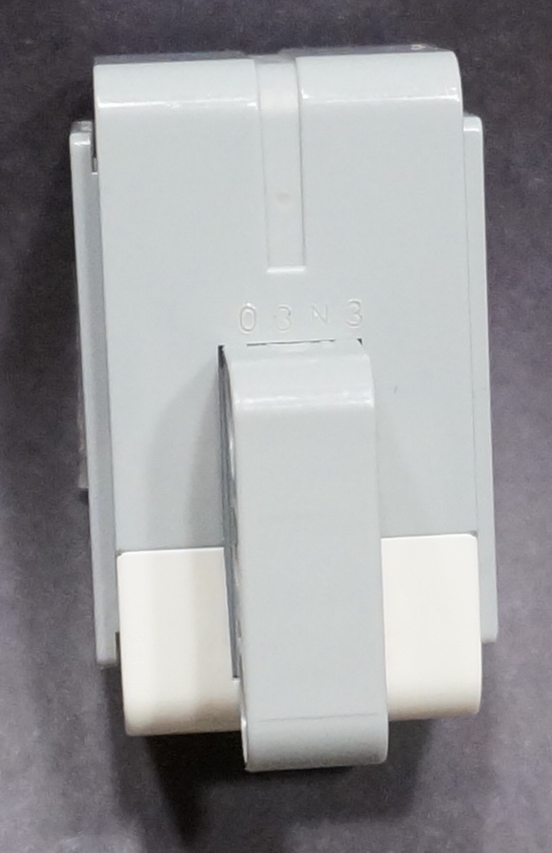
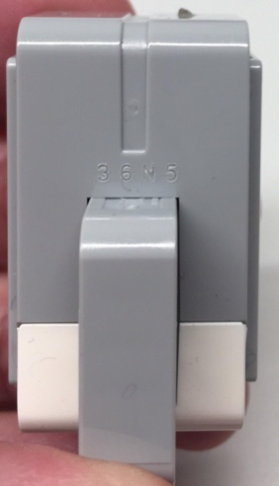
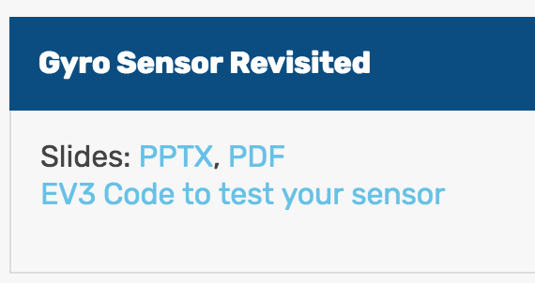
What Sensor Version Do You Own?
Method 1: You can look for the tiny code printed on the gyro sensors and look at the last two Letter-Digit combination
Method 2: You can run the test code we have provided for you on EV3Lessons→ Advanced and it will tell you which sensor you have and if the traditional recalibration or an alternative recalibration method is needed.
http://ev3lessons.com/en/ProgrammingLessons/advanced/GyroRevisited.ev3
See next slide for zoomed in versions
“N3”
“N5”
Photo Credit:
Thomas Madeya

Slide 8
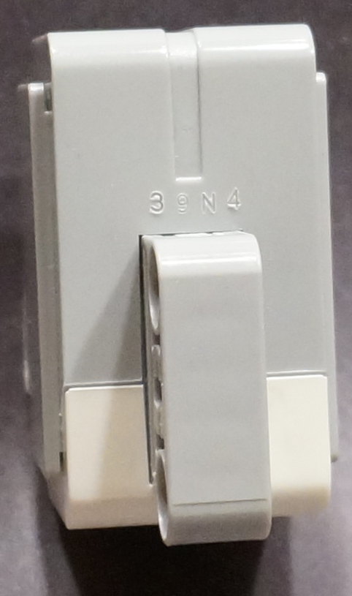

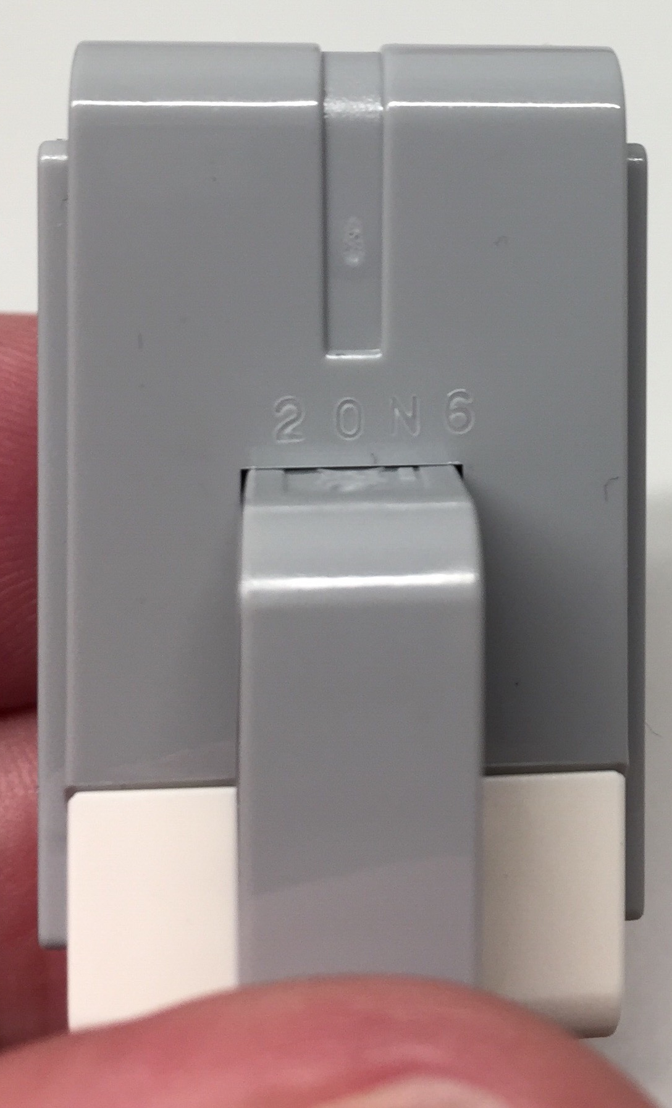
Close up View of the Sample Codes
“N3”
“N4”
“N5”
“N6”
Wherever this presentation mentions N4, the result has been confirmed for N5, N6, N7 as well.
Wherever this presentation mentions N3, the result has been confirmed for N2 as well.
Photo Credit: “N5” and “N6” Images by Thomas Madeya

Slide 9
What if Don’t Own an N2/N3 Sensor?*
Hardware Solution
Software Solution
Unplug and re-plug your gyro sensor while making sure your robot is still
This technique requires access to the EV3 ports and is prone to failure since you may shake the robot as you re-plug the wire.
If you read the port the gyro is connected to as an infrared sensor and then read it again as a gyro sensor, it seems to force a recalibration of the gyro.
See the next 4 slides for updated recalibration code (Strategies 5-8) that can be used for the “N4” and up sensors.
Can be used with “N3” and below as well.
Note: Did not work reading the sensor as color, ultrasonic, touch or temperature.
* As we discover more solutions, this slide will be updated.

Slide 10
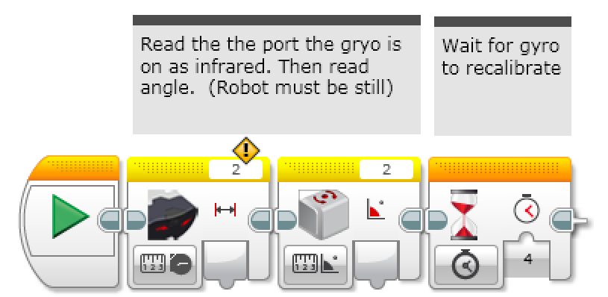
Recalibration Strategy 5
First, reading the gyro as an IR sensor and then as a gyro causes the gyro to recalibrate.
Second, add a wait block to give the sensor a bit of time to fully recalibrate. Our measurements show that 4 seconds is safe. Note that the Strategy 1 code in Intro to Gyro, recalibration only took 0.1 seconds.
Note for “N3” sensor users: in the rest of your program, you should only use the “angle” modes of the gyro. Using the “rate” or “rate and angle” mode will cause the gyro to recalibrate. “N4” sensor users can change modes without causing a recalibration. Mode changes do “reset” the angle to 0.

Slide 11
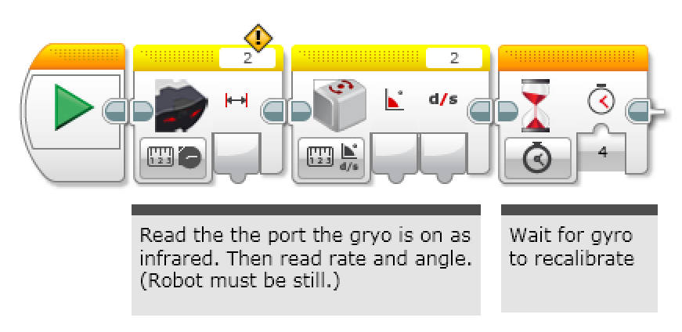
Recalibration Strategy 6
This version of the calibration leaves the gyro in rate+angle mode. This is useful for “N3” users if you use the rate output.
This version takes a little bit longer (4 vs. 3 seconds) than the Strategy 2 code in Intro to Gyro.
Note for “N3” sensor users: in the rest of your program, you should only use the “rate + angle” modes of the gyro. Using the "angle" or “rate” mode will cause the gyro to recalibrate. Also, ***DO NOT*** use the gyro reset mode - this forces the gyro into angle mode which will cause a long 3 second recalibration. “N4” sensor users can change modes without causing a recalibration. Mode changes do “reset” the angle to 0.

Slide 12
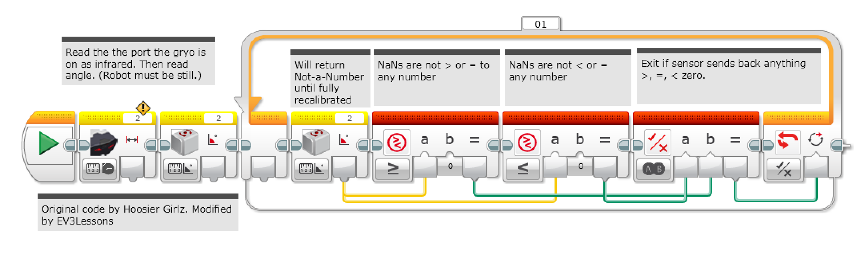
Recalibration Strategy 7
This version of the calibration leaves the gyro in angle mode. This is probably the most common way to use the gyro. This code takes about 4 sec to run (vs. 0.1 sec for the Strategy 3 code in Intro to Gyro)
Note for “N3” sensor users: in the rest of your program, you should only use the “angle” modes of the gyro. Using the “rate” or “rate and angle” mode will cause the gyro to recalibrate. “N4” sensor users can change modes without causing a recalibration. Mode changes do “reset” the angle to 0.

Slide 13
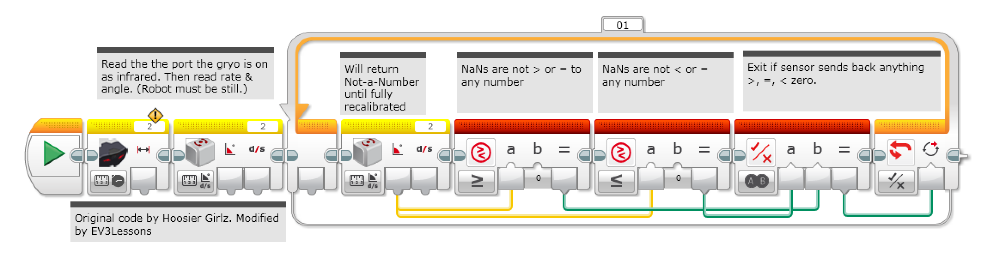
Recalibration Strategy 8
This version of the calibration leaves the gyro in rate+angle mode. This is useful for “N3” users if you use the rate output.
Note for “N3” sensor users: in the rest of your program, you should only use the “rate + angle” modes of the gyro. Using the "angle" or “rate” mode will cause the gyro to recalibrate. Also, ***DO NOT*** use the gyro reset - this forces the gyro into angle mode which will cause a long 3 second recalibration. “N4” sensor users can change modes without causing a recalibration. Mode changes do “reset” the angle to 0.

Slide 14
Discussion
The new gyro calibration strategies in this lesson work for either the N2-N3 or N4-N8 sensors
Note that all the new recalibrations take about 3-4 seconds. This is significantly more than the previous strategy 1 and 3 (in the Intro to Gyro lesson) which left the gyro in angle reading mode (0.1 sec vs. 3-4 secs)
Therefore, if you have older N2 and N3 gyros, you might want to use the old code that took less time to recalibrate.
The newer N4-N8 sensors allow you to use different gyro modes inside a program without causing a recalibration.
Conclusion: There was a hardware change between the N3 and N4 gyros. The older gyros likely use ISZ-655 (a single axis gyro chip).

Slide 15
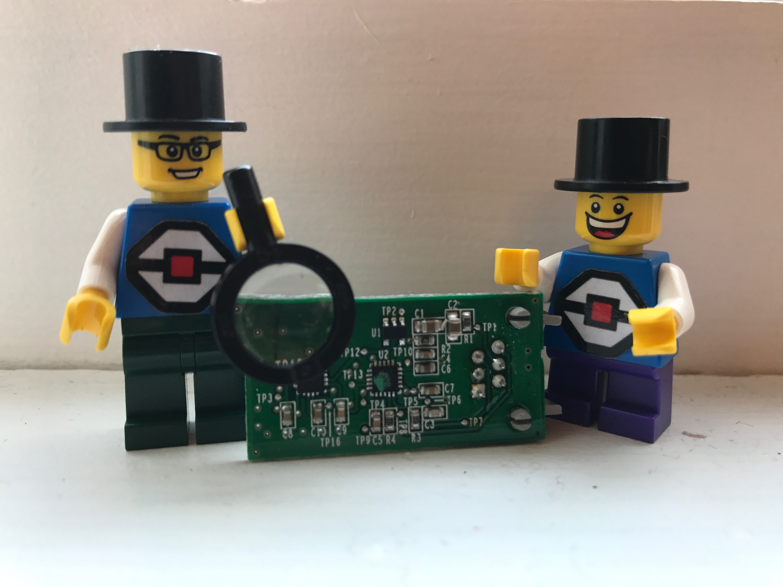
What is Going On?
Thanks to the community sending in all the codes on the gyro sensors, it does appear that there is a date code on every gyro sensor. 45N5 = [Week][Factory/Electronics][Year] = Week 45, N, 2015
By running EV3Dev, David Lechner, was able to identify that newer sensors have some additional secret modes enabled by the new hardware inside the sensor. The newer sensors have a dual-axis gyro chip so it can measure angle and rate about a second axis (parallel to the cable)
Note: These modes are not accessible through the standard EV3-G Gyro block even if you own the newer gyro sensors. The modes are referred to as "TILT-ANG" and "TILT-RATE” in the sensor itself.
Watch https://youtu.be/KjlT0BUJr-w for how David Lechner discovered the different modes.
Credit: This information on this slide was provided by David Lechner and Jorge Pereira

Slide 16
What Does This Mean for Calibration?
Lechner believes that with N4, N5, N6, N7 and N8 sensors, since there are new (hidden) modes that measure rotation around a different axis, the sensor no longer resets when switching modes from angle to rate.
The IR Sensor Block works in our solution code because it forces the sensor communication to timeout and causes the sensor to reset. This is because the LEGO firmware handles the IR sensor differently (longer timeout).
Credit: This information on this slide was provided by David Lechner and Jorge Pereira

Slide 17

Credits
This tutorial was written by Sanjay Seshan and Arvind Seshan
More lessons at www.ev3lessons.com
Thank you to Mr. Sam Last for first reporting this issue to us.
Thank you to David Lechner for investigating and discovering the hidden modes of the newer sensor.
This work is licensed under a Creative Commons Attribution-NonCommercial-ShareAlike 4.0 International License.

